Slide 1
RECIPE MANAGEMENT SYSTEM
TEAM MEMBERS Name:Pratigya Paudel Roll No:THA076BCT029
Name:Sudeep kaucha Roll No:THA076BCT044
Name:Aashish kumar sah Roll No:THA076BCT001
Name :Prabin Sharma Poudel Roll No:THA076BCT027
SUPERVISOR: Er. Rama Bastola
Institute of Engineering
Department of Electronics and Computer Engineering
Thapathali Campus
Presentation date:2nd March,2019

Slide 2
PRESENTATION OUTLINE
Motivation
Objectives
Introduction
Methodology
Demo
Conclusion
Further Works
References

Slide 3
MOTIVATION
In the context of cooking world,there are lots of apps and management system that provides user recipes but not in a proper and managed way. We wondered how people will be benefited ,if such system includes all the recipes of food in categorized and properly managed form.This is what made us think about this project.

Slide 4
OBJECTIVES
To view desired recipe according to different categories,
To enable the user to add their own cuisines in the program and save other cuisines for further use.

Slide 5
INTRODUCTION
Introduction to the Recipe management system
Why is this program irony cooking world?
Discussion
Pros and cons of other recipe management programs
Introduction to RECIPE MANAGEMENT SYSTEM
Pros and cons of RECIPE MANAGEMENT SYSTEM
Short outline of the program
Areas of use of Recipe management system

Slide 6
METHODOLOGY
Food sections and directions
This is the main part of the whole project
To be used by the all user who needs the recipes
Simple application to user for displaying recipes in properly managed and categorized form along with ingredients

Slide 7
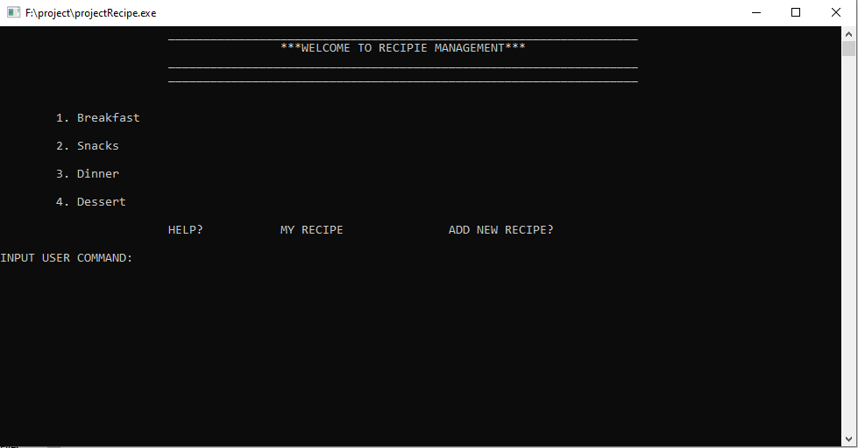
this is list of recipes you can choose
this is the additional functions user can use
here user can input command

Slide 8
METHODOLOGY
Sign in and add users
An application provides user login id in the system also to add users
Uses database provided by the sign in application for logging in
Functions such as adding, editing, searching and deleting the data.

Slide 9
METHODOLOGY
View counter
This application is about counting the views on a paricular recipe
Recipe with highest numbers of views is displayed on the top

Slide 10
METHODOLOGY
Add comments
This application allows user to include their views about recipes
Those views and comments are then displayed along with the recipes
Demo:

Slide 11
METHODOLOGY
Other consoles

Slide 12
CONCLUSION
We have presented how effective it is to use these kind of applications over the old systems.
We have just presented an idea or concept that how RECIPE MANAGEMENT SYSTEM can be made in recent future for categorized and sort recipes,allow user to add recipes,allow to add user have their own user login id ,add comment about it and also the counting of viewers.
Questions?

Slide 13
FURTHER WORKS
User login accessing with their passwords
Reviews of recipes
Likes and dislikes can be added and counted on particular recipe
Our program is just a sample for few recipes. It can be extended for world wide quisines and food.
We promise to update
Suggestions?

Slide 14
REFRENCES
R.D. Bhatta and B.R. Dawadi , A textbook of C programming,bhotahity,Kathmandu:Vidyarthi Pustak Bhandar,2018
A Kelley and I.Pohl,a book on C ,4th ed.India:Dorling Kindersley Pvt,Ltd.,2009.
Y.Kanetkar,let us C,16th ed.india:BPB publications,2017.
Meal planner
Allrecipes.com
Thekitchn.com

